Slide 1
John Deardurff Senior Technical Instructor MCSA, MCSD, MCSE, MCDBA, MCITP, MCT
Transact-SQL Study Guide

Slide 2
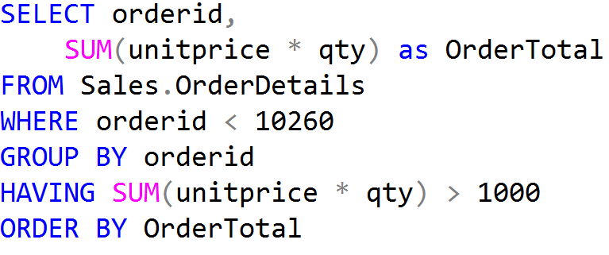
What is a SQL?
Structured Query Language
Microsoft Database Server

Slide 3
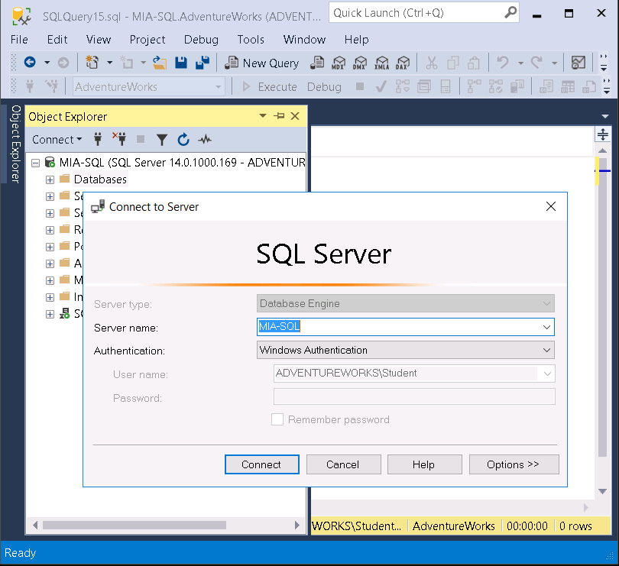
Client/Server Architecture
Requests Data
Relational Engine
SQLOS
Storage Engine
Provides Data
The Database Engine
Client
Server

Slide 4
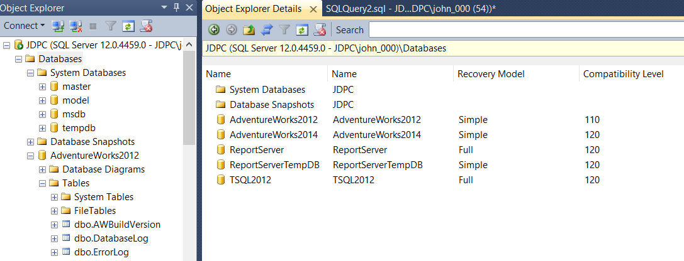
SQL Server Management Studio
System databases
User Defined databases

Slide 5
System Databases | Description
master | Stores all system-level configuration
msdb | Holds SQL Server Agent configuration including job, backup and restore history
model | Is the template for new databases
tempdb | Holds temporary data like temporary tables, table variables, hash tables and the row version store
resource | Hidden read-only database that contains system objects that are mapped to the sys schema of databases

Slide 6
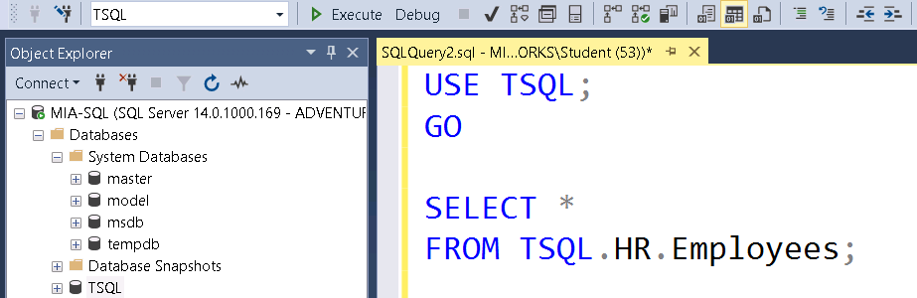
SQL Editor Toolbar and Query Editor Window
Available Databases
Execute (F5)
Parse
Intellisense
Comments
Indents
Three places where database names can be referenced.

Slide 7
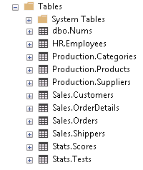
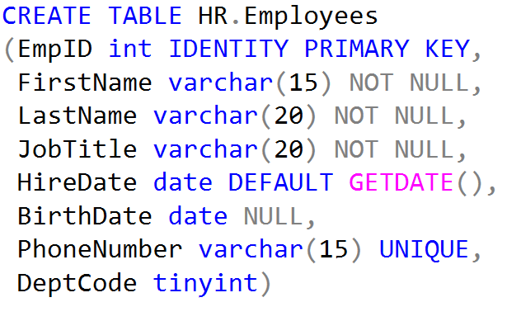
What is a Schema?
Definition of an Object
Organization of Objects
(For Management and Security)

Slide 8

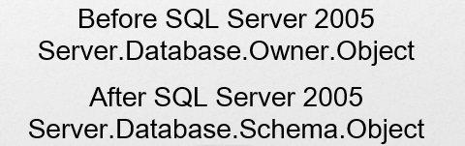


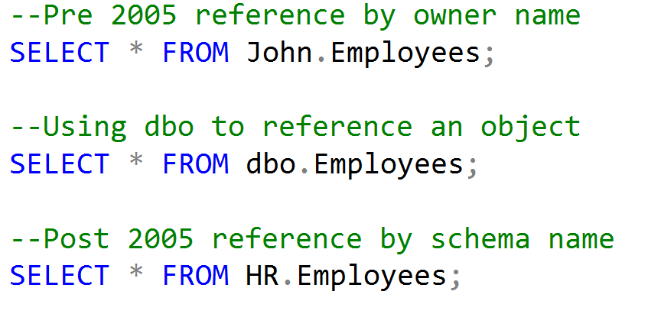



Securables and the Four-Part Name
SQL Server Instance
Server-level objects
Database
Database-level objects
Schema
Schema
Objects
Objects

Slide 9
SQL Statement Categories
DML (Manipulation) | DCL (Control) | DDL (Definition) | TCL (Transactional)
INSERT | GRANT | CREATE | BEGIN
UPDATE | DENY | ALTER | COMMIT
DELETE | REVOKE | DROP | ROLLBACK
SELECT (DQL) |  | TRUNCATE | SAVE

Slide 10
Logical Query Processing
The order in which a query is written is not the order in which it is processed.
Order | Keywords | Expression | Purpose
5 | SELECT | <select list> | Specifies which columns to return.
1 | FROM | <table source> | Defines the table(s) to query
2 | WHERE | <search condition> | Filters out the records to return
3 | GROUP BY | <group by list> | Arranges records into groups
4 | HAVING | <search condition> | Filters down the groups
6 | ORDER BY | <order by list> | Sorts the returned records
Notes:
Note that for the purposes of this discussion, TOP, DISTINCT and OVER are omitted.
This is a build slide - be sure to review this slide and its animation before presenting it.

Slide 11








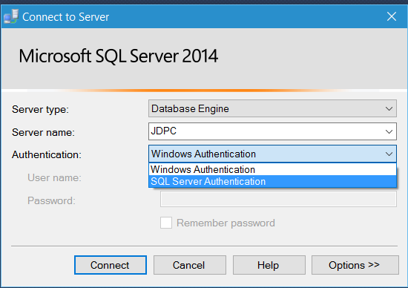




Security Principals
Authenticated by Windows
SQL Server Instance
User name
&
Password
Windows User
Windows Group
Windows Login
SQL Server Login
Authenticated by SQL Server
Server Role
Database
Database User
Database Role
Application Role

Slide 12



Principals vs Securables
Tables
Permissions
Views
Sales Role
Sales Schema
Database Users
Stored Procedures
Principals
Securables

Slide 13
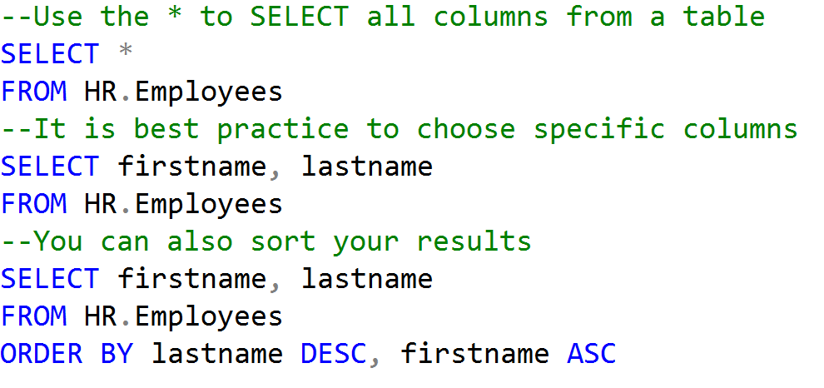
Using the SELECT statement

Slide 14
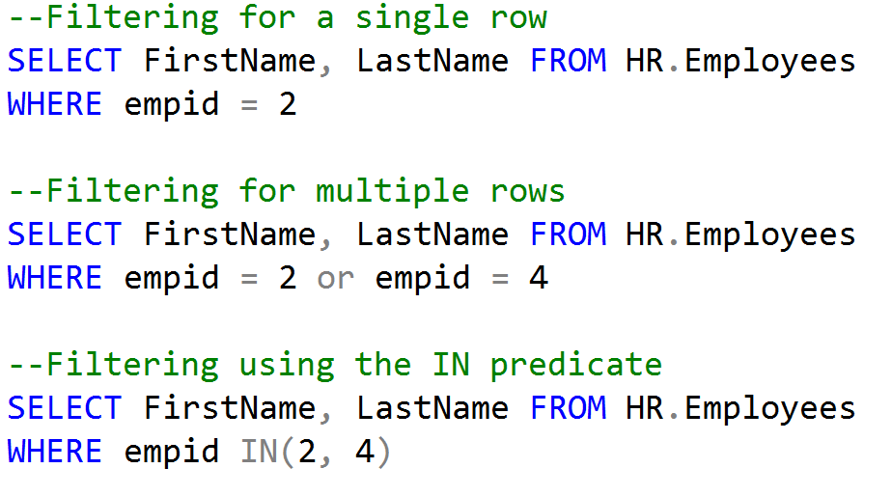
Filtering Records with the WHERE statement

Slide 15
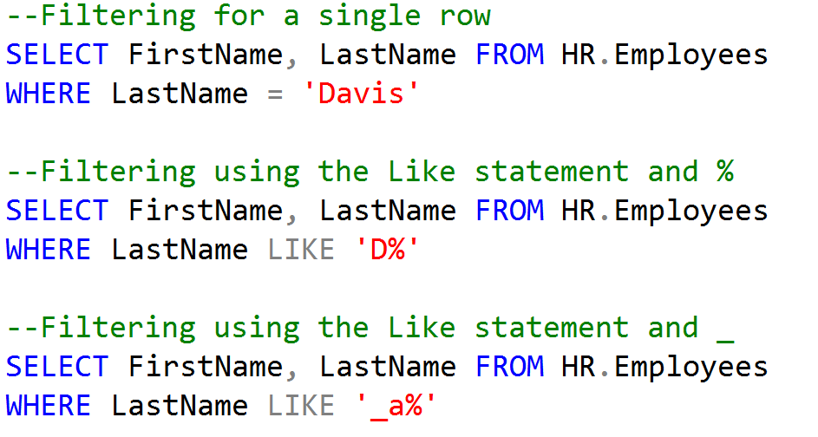
Filtering Records with the WHERE statement

Slide 16
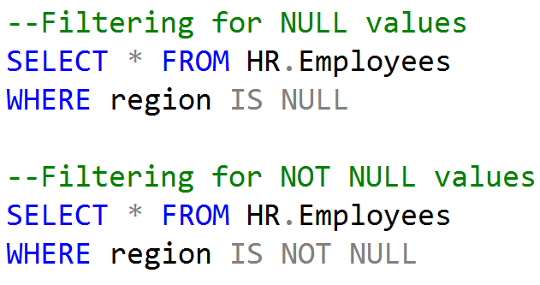
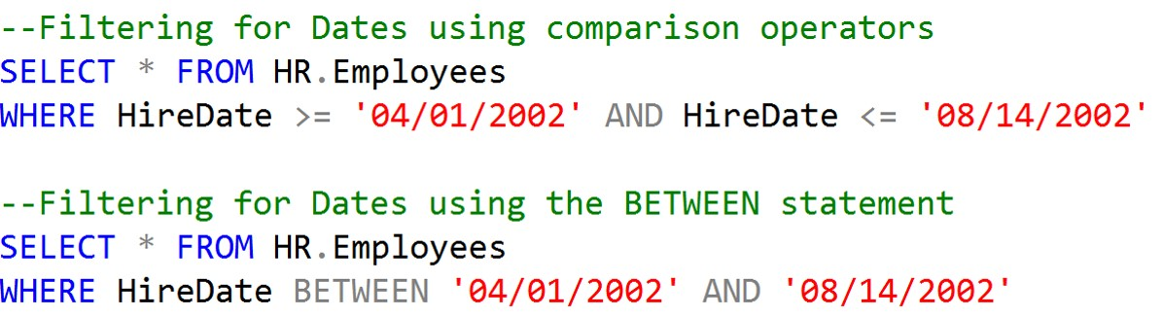
Filtering Records with the WHERE statement

Slide 17
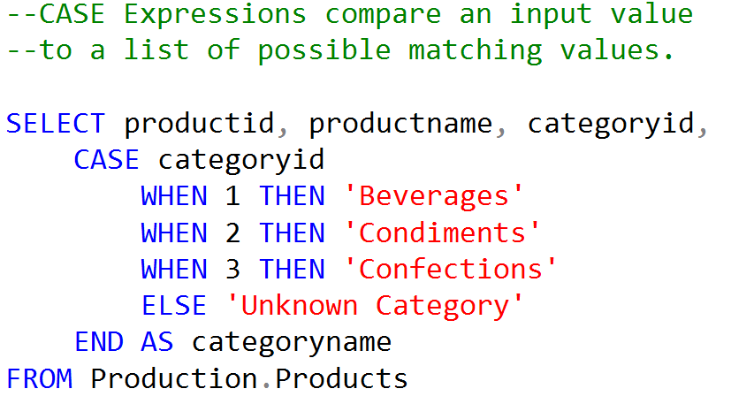
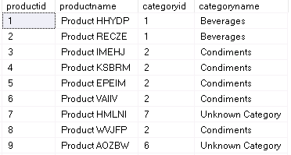
CASE Expressions

Slide 18
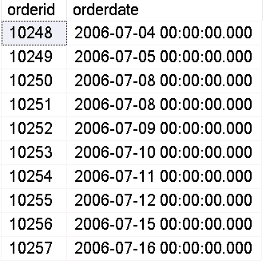
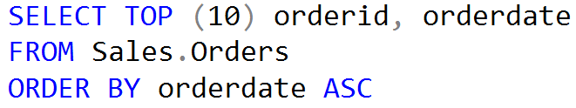
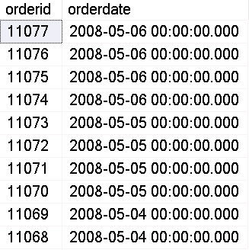
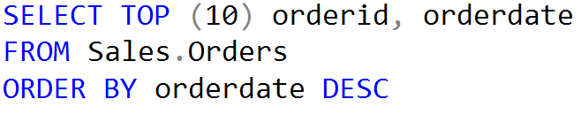
ORDER BY TOP VALUES
Top 10
Bottom 10

Slide 19
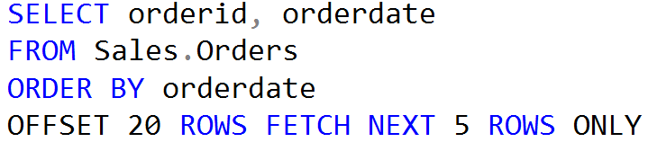
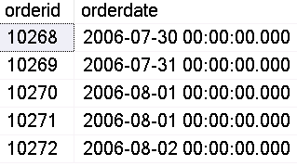
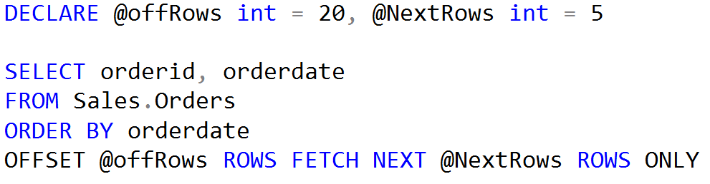
OFFSET…FETCH
Using Variables

Slide 20
Ground rules for database design
Identify Database Purpose
Review Existing Data
Make a Preliminary list of fields
Group fields into tables
Review for Maintenance problems
Designate Primary Key

Slide 21
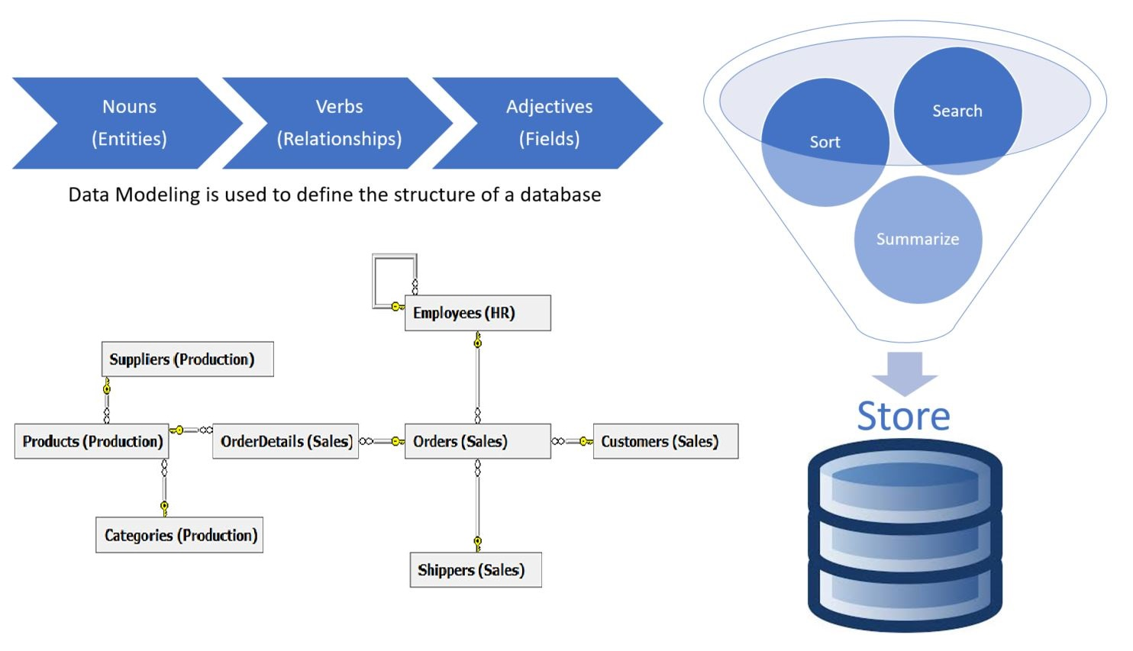

Slide 22
Why Normalize Data?
Save the typing of repetitive data
Save storage space
Avoid frequent restructuring of tables and other objects to accommodate new data
Increase flexibility to search, sort, summarize, and store data.

Slide 23

Codd’s Law
A non-key field must provide a fact about
NF1 – the key
NF2 – the whole key
NF3 – and nothing but the key
So help me Codd.

Slide 24
First Normal Form
Locate or create a unique field to be a Primary Key.
Separate fields into small, meaningful values.
Move repeating groups of fields into a separate table.
Second Normal Form
Move fields with repeating data into a separate table.
Third Normal Form
Move fields that don’t relate to every record into a separate table.

Slide 25
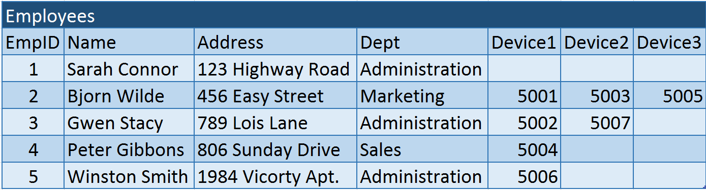
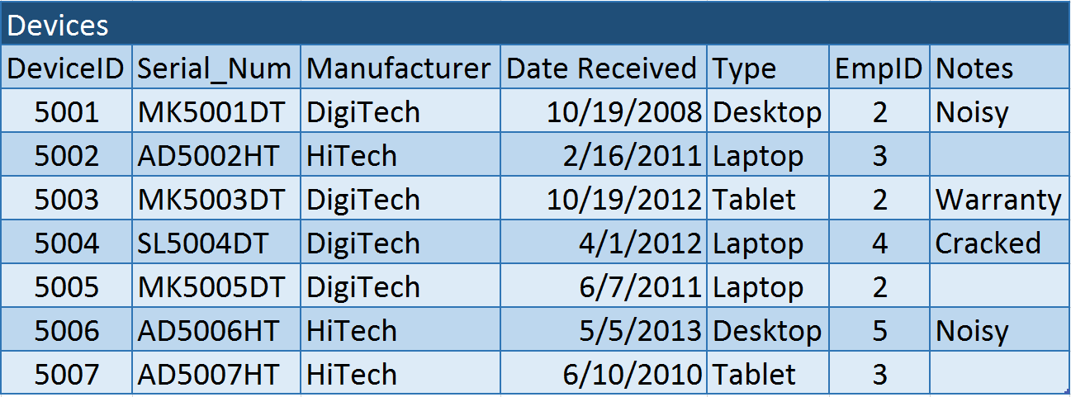
Data before Normalization

Slide 26
Finding Relationships
Employees
EmpID
LastName
FirstName
Address
City
State
Zip
Phone
HireDate
Dept_Code
Devices
DeviceID
Serial_Num
ManfactID
DateReceived
TypeID
EmpID
Notes
Device_ID
Note
Manufacturers
ManufacturerID
Manufacturer
Departments
DeptCode
DeptName
DeviceType
Type_ID
ComputerType
Primary Key within a table is the unique identifier
Primary Key within a relationship is the best describer of the connecting field
Foreign Key within a relationship connects Child table to Parent table

Slide 27
Join Types
Customers
Orders
Parent
Table
Child
Table
Left Outer
All Customers
with or without an Order
Right Outer
Orders
with or without Customers
Inner
Only Customers who have placed Orders

Slide 28
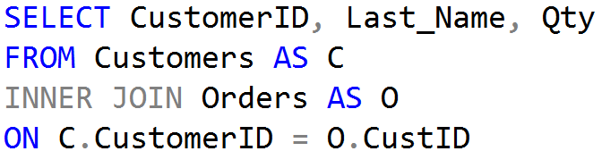
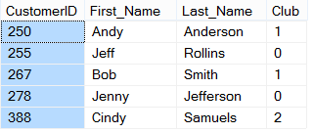
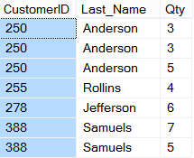
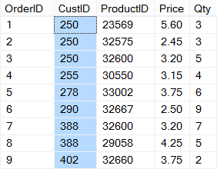
Inner Joins
CUSTOMERS
ORDERS

Slide 29
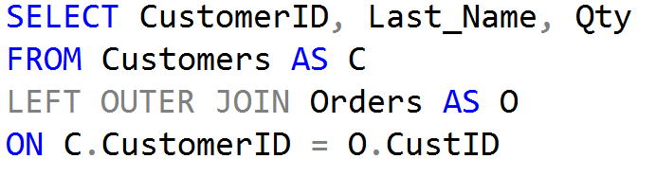
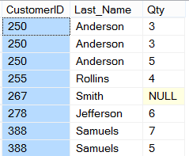
Left Outer Joins
CUSTOMERS
ORDERS

Slide 30
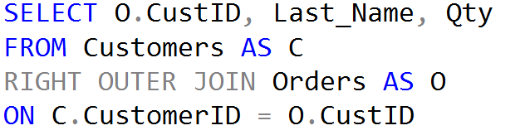
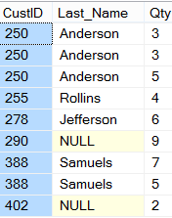
Right Outer Joins
CUSTOMERS
ORDERS

Slide 31
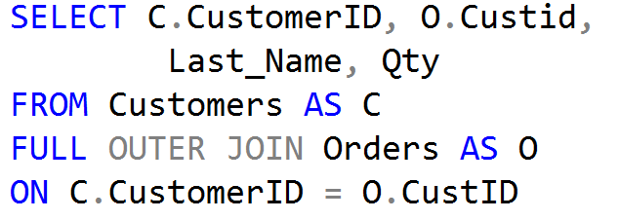
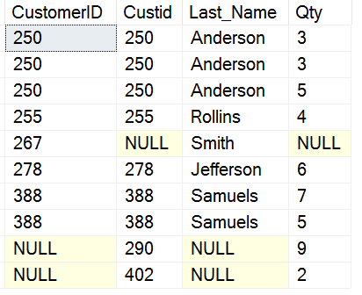
Full Outer Joins
CUSTOMERS
ORDERS

Slide 32
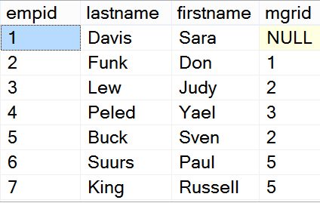
Self Joins: Comparing data within a table
Start with employee whose manager you want to find.
Observe the value in the mgrid column.
Locate the matching value in the empid column.

Slide 33
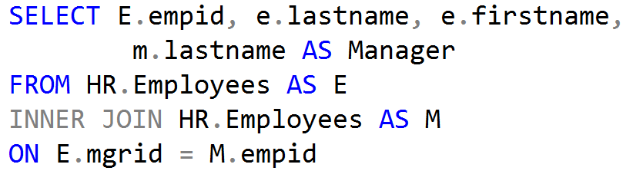
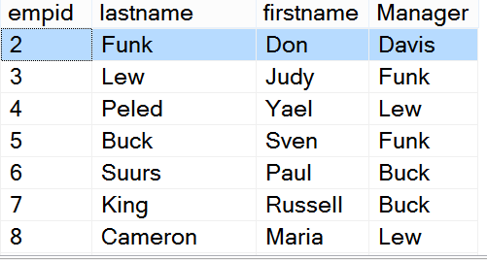
Writing a Self Join

Slide 34
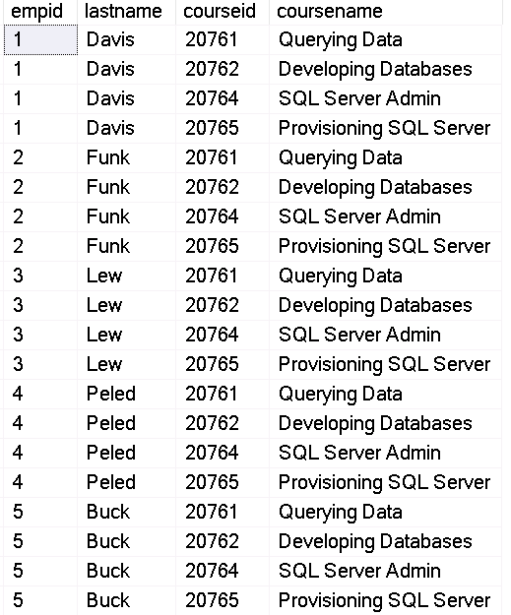
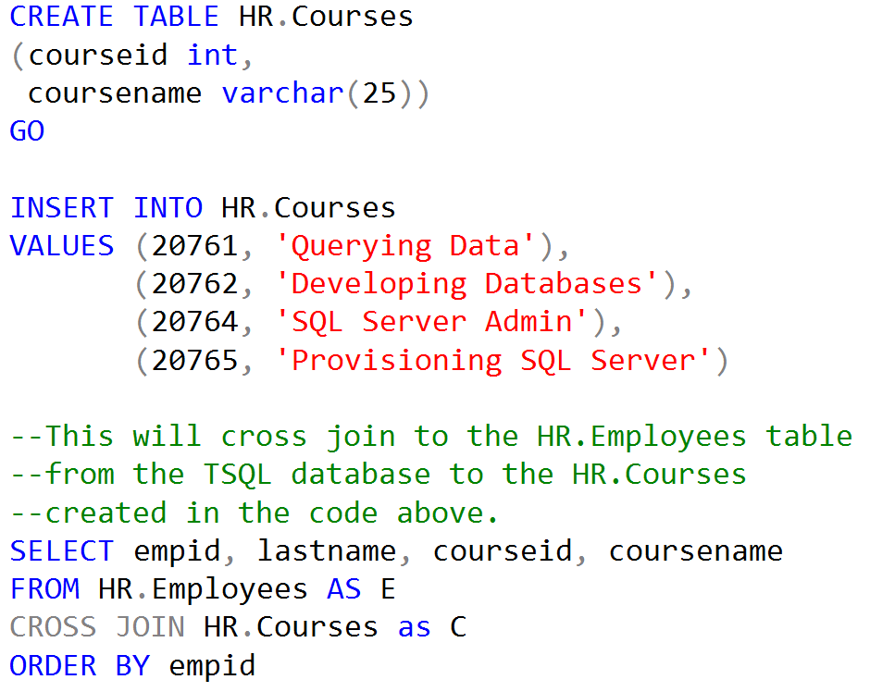
Cross Joins

Slide 35
Constraints
PRIMARY KEY – Ensures that a column has a unique value for each record.
NOT NULL – Enforces that every record has a value for the column
DEFAULT – Specifies a value for the column when a value is not included
UNIQUE – Enforces that each column uses distinct and unique values
CHECK – Enforces specific rules that a column must follow
FOREIGN KEY – Enforces the child relationship with a parent table

Slide 36
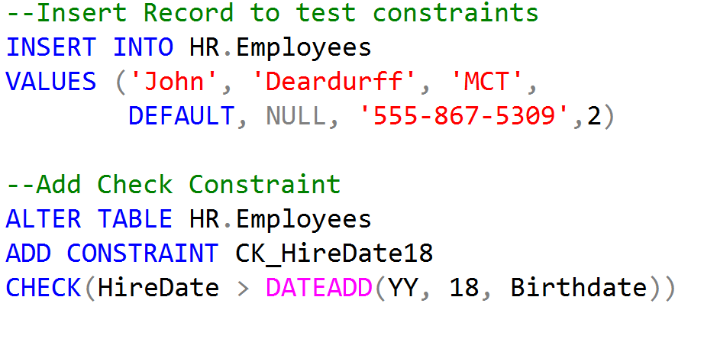
Adding a CHECK constraint

Slide 37
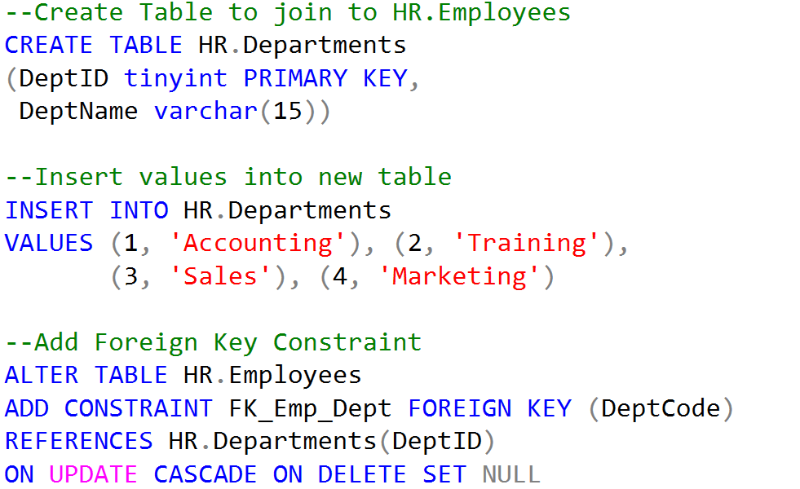
Foreign Key Constraints

Slide 38
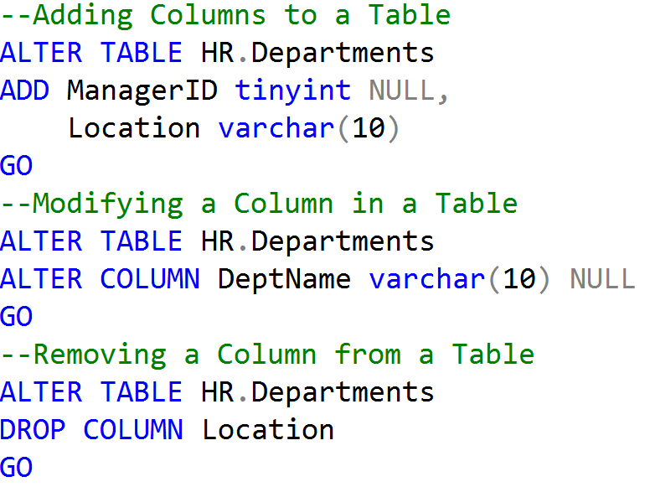
Altering Tables

Slide 39
Why Data Types Matter
Used for Columns, Variables, Expressions, & Parameters
Fundamental to writing queries in T-SQL
Fundamental to designing tables.
Choosing the right data type ensures data integrity and accuracy by creating a constraint on data input
Choosing the right data type can save hard drive space, space in memory, and bandwidth on your network

Slide 40




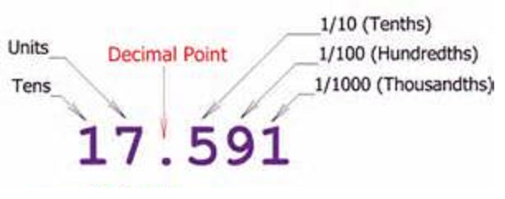
SQL Server Data Types
Data types determine what kind of data can be held:
Integers, characters, dates, money, decimals, etc.

Slide 41


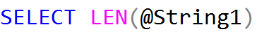
Data Type Usage
Columns
Expressions
Variables
Parameters

Slide 42
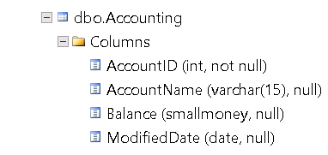
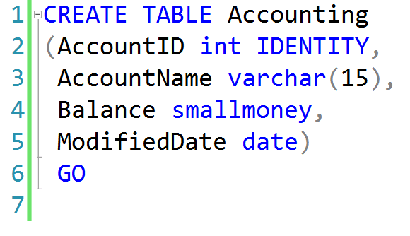
Using Data Type with Columns

Slide 43
Character Data Types
Data Type | Range | Storage
CHAR(n), NCHAR(n) | 1-8000 characters 1-4000 characters | bytes 2*n bytes
VARCHAR(n), NVARCHAR(n) | 1-8000 characters 1-4000 characters | n+2 bytes (2*n) +2 bytes
VARCHAR(MAX), NVARCHAR(MAX) | 1-2^31-1 characters | Actual length + 2

Slide 44
Character Data Types
Fixed
Variable
Regular
char
varchar
1 byte per char
Unicode
nchar
nvarchar
2 bytes per char

Slide 45
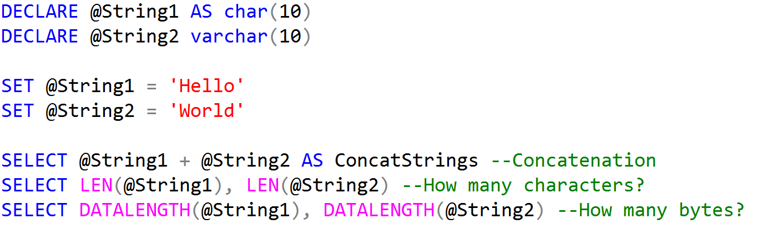
Character Data Code Example

Slide 46
Rows stored in Data Pages
Page Header
(96 bytes)
Header contains Page Information such a Page Number and Page Type
Data Row 1
Data Row 2
Data Row 3
8060 bytes for Data Rows or Free Space
Free Space
Row Offset Array
Displays how far from beginning of page each row is located.

Slide 47
FixVar Row Format
Header
Fixed
Null
Variable
Length of Fixed Width Columns
2 bytes
Variable Width
Offset Array
2 bytes per
Variable Column
NULL Bitmap
1 Byte per
8 Null Columns
Number of Variable Width Columns
(2 Bytes)
Number of Total Columns (2 Bytes)
Header Byte 1
Header Byte 2
Fixed Width Data
Variable Width Data
Notes:
This is the FixVar format for a column for IN ROW Data Storage.

Slide 48
Integer Data Types
Data type | Range | Storage (bytes)
tinyint | 0 to 255 | 1
smallint | -32,768 to 32,767 | 2
int | 2^31 (-2,147,483,648) to 2^31-1 (2,147,483,647) | 4
Bigint | -2^63 - 2^63-1 (+/- 9 quintillion) | 8
bit | 1, 0 or NULL | 1

Slide 49
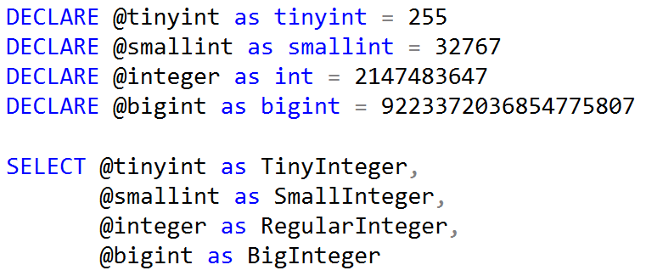
Integer Data Type Coding Example

Slide 50
Other Numeric Data Types
Data type | Range | Storage (bytes)
decimal/numeric | 10^38 +1 through 10^38 – 1 when maximum precision is used | 5-17
money | -922,337,203,685,477.5808 to 922,337,203,685,477.5807 | 8
smallmoney | - 214,748.3648 to 214,748.3647 | 4
float /real | Approximate data type for floating point numeric data | 4-8

Slide 51
Date and Time Data Types
Data Type | Storage (bytes) | Date Range | Accuracy
DATETIME | 8 | January 1, 1753 to December 31, 9999 | 3-1/3 milliseconds
SMALLDATETIME | 4 | January 1, 1900 to June 6, 2079 | 1 minute
DATETIME2 | 6 to 8 | January 1, 0001 to December 31, 9999 | 100 nanoseconds
DATE | 3 | January 1, 0001 to December 31, 9999 | 1 day
TIME | 3 to 5 |  | 100 nanoseconds
DATETIMEOFFSET | 8 to 10 | January 1, 0001 to December 31, 9999 | 100 nanoseconds

Slide 52
Date and Time Data Types
Older versions of SQL Server supported only DATETIME and SMALLDATETIME
DATE, TIME, DATETIME2, and DATETIMEOFFSET introduced in SQL Server 2008
SQL Server doesn't offer an option for entering a date or time value explicitly
Dates and times are entered as character literals and converted explicitly or implicitly
For example, CHAR converted to DATETIME due to precedence

Slide 53


Working with Date and Time Separately
DATETIME, SMALLDATETIME, DATETIME2, and DATETIMEOFFSET include both date and time data
If only date is specified, time set to midnight (all zeroes)
If only time is specified, date set to base date (January 1, 1900)

Slide 54



Working with Time Accuracy

Slide 55


Date Functions

Slide 56
Data Type Precedence
Data type precedence determines which data type will be chosen when expressions of different types are combined
Data type with the lower precedence is implicitly converted to the data type with the higher precedence
Conversion to type of lower precedence must be made explicitly (with CAST or CONVERT function)
CHAR -> VARCHAR -> NCHAR -> NVARCHAR -> BIT -> TINYINT -> SMALLINT -> INT -> BIGINT -> MONEY -> DECIMAL -> TIME -> DATE -> DATETIME2 -> XML
https://docs.microsoft.com/en-us/sql/t-sql/data-types/data-type-precedence-transact-sql

Slide 57

Data Type Conversion Functions

Slide 58

Data Type Conversion Functions

Slide 59


STRING Functions

Slide 60


Replace Function

Slide 61


Formatting Date and Time

Slide 62
Date and Time Format Strings
Specifier | Description | Examples
d | Short date | 5/31/2011
D | Long date | Tuesday, May 31, 2011
f | Full date/time (short time) | Tuesday, May 31, 2011 12:00 AM
F | Full date/time (long time) | Tuesday, May 31, 2011 12:00:00 AM
g | General date/time (short time) | 5/31/2011 12:00 AM
G | General date/time (long time) | 5/31/2011 12:00:00 AM
m or M | Month/Day | May 31

Slide 63
.Net Cultures
Country | Language | Culture
France | French | fr-FR
France | Corsican | co-FR
Germany | German | de-DE
United Kingdom | Welsh | cy-GB
United Kingdom | English | en-GB
United States | English | en-US
United States | Spanish | es-US
https://azuliadesigns.com/list-net-culture-country-codes/

Slide 64


Custom Date and Time Format

Slide 65

Number Formats

Slide 66
Number Format Strings
Specifier | Description | Examples
c or C | Currency | $2024.99
g or G | General | 2024.9940
n or N | Number | 2024.99
n3 or N3 | Decimal (3 would indicate 3 decimal places) | 2024.994
p or P | Percent | 202,499.50%

Slide 67
Additional Data Types
Data type | Range | Storage (bytes)
rowversion | Auto-Generated | 8
uniqueidentifier | Auto-Generated | 16
xml | 0-2 GB | 0-2 GB
cursor | NA | NA
hierarchyid | NA | Depends on content
sql_variant | 0-8000 bytes | Depends on content
table | NA | NA

Slide 68




Data Manipulation Language (DML)

Slide 69

Delete vs Truncate vs Drop
TABLE
Page Header
(96 bytes)
Page Header
(96 bytes)
Page Header
(96 bytes)
Page Header
(96 bytes)
Data Row 1
Data Row 4
Data Row 7
Data Row 10
Data Row 2
Data Row 5
Data Row 8
Data Row 11
Data Row 3
Data Row 6
Data Row 9
Data Row 12
Free Space
Free Space
Free Space
Free Space
Row Offset Array
Row Offset Array
Row Offset Array
Row Offset Array

Slide 70


Inserting Values into IDENTITY Columns
The column_list must be used to insert values into an identity column, and the SET IDENTITY_INSERT option must be ON for the table

Slide 71



SEQUENCES
Sequences allow the ability to increment numbers across more than one table.

Slide 72


INSERT… SELECT vs SELECT… INTO
INSERT INTO EXISTING TABLE
SELECT FROM EXISTING TABLE
SELECT FROM EXISTING TABLE
INTO NEW
TABLE

Slide 73




Using the OUTPUT Clause
Using OUTPUT in a DML statement returns data affected instead of rows returned.

Slide 74
Virtual Tables
Inserted and Deleted Virtual Tables allow the ability to access data before and after data modification.
Available in AFTER and INSTEAD of Triggers.
Created at the beginning of a statement.
Statement | Inserted | Deleted
INSERT | Rows just inserted
DELETE |  | Rows just deleted
UPDATE | Modified row contents | Original row contents
Notes:
Point out which data types consume the least storage.

Slide 75





Using MERGE
Student Target
Demo Setup
Student Source
Student Target
Results

Slide 76

What is a Function?
Allows code to perform specific tasks.
Coffee
Function Name
Parameters or Arguments

Slide 77



The GetDate() Function
Function in Object Explorer
Function in Code
Function Results

Slide 78


The Left() Function
Function in Object Explorer
Function
Name
Parameters
Function Results

Slide 79


Conditional Functions

Slide 80


COALESCE Function

Slide 81

Aggregate Functions and Group By Examples
Aggregate Functions
Group By and Having

Slide 82


Using Aggregate Functions with NULL values

Slide 83


Self-Contained Subqueries
Scalar Subquery
Multi-Value Subquery

Slide 84
Comparing Self-Contained and Correlated Subqueries
Outer Query:
SELECT orderid, productid, unitprice, qty
FROM Sales.OrderDetails
WHERE orderid = ( )
Outer Query:
SELECT orderid, empid, orderdate
FROM Sales.Orders AS O1
WHERE
orderdate = ( )
Inner Query:
SELECT MAX(orderid) AS lastorder
FROM Sales.Orders
Inner Query:
SELECT MAX(orderdate) FROM Sales.Orders AS O2
WHERE O2.empid = O1.empid
Self-Contained Subquery:
Correlated Subquery:
Notes:
This slide illustrates the difference between self-contained and correlated subqueries. Do not go into specifics of the queries shown, which you will cover later in this module. Instead emphasize that, in self-contained subqueries, the inner query does not take information from the outer query. By contrast, in a correlated subquery, the inner query requires information from the outer query.
20461D
10: Using Subqueries

Slide 85


Correlated Subqueries

Slide 86

Creating a Scalar Function – End of Month

Slide 87

Creating a Scalar Function – First of Month

Slide 88


Creating Views and Table-Valued Functions
User-Defined View
Table-Valued Function

Slide 89


Derived Tables and Common Table Expressions
Derived Table
Common Table Expression

Slide 90

SET Operators
UNION returns results from both sets without duplicates
UNION ALL returns results from both sets with duplicates
INTERSECT only returns results that appear in both sets
EXCEPT returns rows from first set unless it is in second set

Slide 91


Demonstration Setup for Windowing Functions

Slide 92



Windowing Components
Result set (OVER)
(ROWS BETWEEN)
(PARTITION BY)
(ROWS BETWEEN)
(ROWS BETWEEN)
Notes:
The result set is the window of rows defined by the OVER clause. If there is no partition, then the window includes all rows. If a partition element is defined in the OVER clause, the conceptual subset of rows is called the window partition. If a frame is defined, the window is further restricted to the starting and ending boundaries defined by the frame.
20461D
13: Using Window Ranking, Offset, and Aggregate Functions

Slide 93


Unbounded and Current Row

Slide 94



Ranking Functions Example

Slide 95


What Is Pivoting?
Pivoting data is rotating data from a rows-based orientation to a columns-based orientation
Distinct values from a single column are projected across as headings for other columns—may include aggregation
Results
Pivoted data

Slide 96

Elements of PIVOT
Pivoting includes three phases:
Grouping determines the elements in the FROM clause gets a row in the result set
Spreading provides the distinct values to be pivoted across
Aggregation performs an aggregation function (such as SUM)
Grouping
Spreading
SELECT Category, [2006],[2007],[2008]
FROM (SELECT Category, Qty, Orderyear FROM Sales.CategoryQtyYear) AS D
PIVOT(SUM(QTY) FOR orderyear
IN ([2006],[2007],[2008])) AS pvt
ORDER BY Category;
Results
Aggregation
Notes:
Note that no explicit GROUP BY clause is needed. PIVOT determines the grouping based on those columns in the input table (produced by the FROM clause) which are not used for aggregation or as spreading elements.

Slide 97
Writing Queries with Grouping Sets
SELECT Category, Cust, SUM(Qty) AS TotalQty
FROM Sales.CategorySales
GROUP BY
GROUPING SETS((Category),(Cust),());
Category Cust TotalQty
--------------- ----------- -----------
NULL NULL 999
NULL 1 80
NULL 2 12
NULL 3 154
NULL 4 241
NULL 5 512
Beverages NULL 513
Condiments NULL 114
Confections NULL 372

Slide 98
ROLLLUP and CUBE examples
ROLLUP and CUBE provides a streamline way of defining grouping sets. ROLLUP will summarize based on first parameter. CUBE will summarize all parameters.
SELECT Category, Cust, SUM(Qty) AS TotalQty
FROM Sales.CategorySales
GROUP BY ROLLUP(Category,Cust)
ORDER BY Category, Cust;
SELECT Category, Cust, SUM(Qty) AS TotalQty
FROM Sales.CategorySales
GROUP BY CUBE(Category,Cust)
ORDER BY Category, Cust;

Slide 99

Batches vs Transactions
Batches
Transactions
VS
Sends Code to the Processor
Modifies Data and Objects in the Database

Slide 100


Working with Transactions

Slide 101



Batches and Variable Scope
First Batch Successful
Second Batch Fails

Slide 102

Creating a Synonym

Slide 103

Inserting Records into an IDENTITY Field

Slide 104

Adding Records using a WHILE Loop

Slide 105
What is a Transaction?
A transaction is a series of one or more statements that need to operate as a single logical unit of work.
To qualify as a transaction, the logical unit of work must possess all four of the ACID properties.

Slide 106




Logical Units of Work – Auto Commit Transactions
$200
John
Jane
Transaction 1
Transaction 2

Slide 107

Single Logical Unit of Work – Explicit Transactions
John
Jane
Transaction 1
$200

Slide 108
Transactions must pass the ACID test
Atomicity – All or Nothing
Consistent – Only valid data
Isolated – No interference
Durable – Data is recoverable

Slide 109
Restore
Database Recovery
Data Copy – Create files and copies data
Redo – Applies committed Transactions from log.
Recovery
Undo – Rolls back uncommitted transactions

Slide 110
Transaction Log Recovery
Transaction Recovery
Action Required
1
None
2
Roll forward
3
Roll back
4
Roll forward
5
Roll back
Checkpoint
System Failure

Slide 111

Auto-Commit Transactions without Error Handling
AdventureWorks.ldf
Checkpoint
AdventureWorks.mdf
John, don’t forget to demonstrate
SET XACT_ABORT ON

Slide 112

Explicit Transactions without Error Handling
AdventureWorks.ldf
Checkpoint
AdventureWorks.mdf

Slide 113

Explicit Transactions with Error Handling
AdventureWorks.ldf
AdventureWorks.mdf
Checkpoint

Slide 114




What is a Lock?
Transaction 1
Transaction 2
TSQL2012.mdf

Slide 115

Altering a Stored Procedure

Slide 116

Ad Hoc Query
First Time
Stored Procedure
Syntax
Parse
Execution Context
Resolve
(Binding)
Compile
Optimize
Estimated
Execution Plan
Procedure Cache
Compile
Compile
Actual
Run Time
Execute
Execute
Execute
Execute
SQL
SQL
Sets
Sets

Slide 117
Query Process
Relational Engine
Resource Access
SQLOS
Storage Engine
Data Access
The Database Engine

Slide 118
How Data Is Stored in SQL Server
Data Row
Data Row
Data Row
Free Space
Data Row
Free Space
Data Row
Data Row
Data Row
Data Row
Free Space
Data Row
Free Space
Free Space
Free Space
Free Space
Data Row
Data Row
Data Row
Data Row
Data Row
Data Row
Free Space
Data Row
Data Row
Data Row
Data Row
Free Space
Data Row
Data Row
Free Space
Free Space
Primary Data File (.mdf)
Secondary Data File (.ndf)
Extent: Eight contiguous 8kb pages
Notes:
Provide an overview of how the data is stored on SQL Server. Describe each of the three data file types and the basic internal layout of the data files. Stress that the file extension .mdf is not mandatory to use but is highly recommended.
Describe the difference between uniform and mixed extents. Note that continued support for mixed extents adds complexity to the database engine for no real benefit. The size of an extent (64 KB) is so small that the original benefit from the mixed extent design is now irrelevant.
Briefly explain that all transactions are written to the log file using the WAL mechanism to ensure the integrity of the database in case of a failure and to support rollbacks of transactions. Explain that data changes occur in the buffer pool and are not written immediately to the data files.
Avoid discussing filegroups at this point, as they will be covered later.
20462C
3: Working with Databases and Storage

Slide 119

SQL Server Disk I/O (Write-Ahead Logging)
4
1. Data modification is sent to buffer cache in memory.
1
2
4. Log cache record is flushed to the transaction log
2. Modification is recorded in the log cache.
3
5. At checkpoint, dirty data pages are written to the database file.
Data Page
Data Row
3. Data pages are located or read into the buffer cache and then modified.
Data Row
5
Data Row
Free Space
Notes:
This section describes the role of the write-ahead transaction log in recording data modifications to disk. SQL Server uses a write-ahead logging (WAL) algorithm, which guarantees that no data modifications are written to disk before the associated log record is written to disk. This maintains the ACID properties for a transaction.
To understand how the write-ahead log works, it is important for you to know how modified data is written to disk. SQL Server maintains a buffer cache into which it reads data pages when data must be retrieved. When a page is modified in the buffer cache, it is not immediately written back to disk; instead, the page is marked as dirty. A data page can have more than one logical write made before it is physically written to disk. For each logical write, a transaction log record is inserted in the log cache that records the modification. The log records must be written to disk before the associated dirty page is removed from the buffer cache and written to disk. The checkpoint process periodically scans the buffer cache for buffers with pages from a specified database and writes all dirty pages to disk. Checkpoints save time during a later recovery by creating a point at which all dirty pages are guaranteed to have been written to disk.
Writing a modified data page from the buffer cache to disk is called flushing the page. SQL Server has logic that prevents a dirty page from being flushed before the associated log record is written. Log records are written to disk when the log buffers are flushed. This happens whenever a transaction commits or the log buffers become full.
Key Points:
SQL Server uses the buffer pool to minimize the amount of disk I/O that must be done against the data file. When a page is required for a read or write operation, the buffer pool is checked first. If the page is already in the buffer pool, the operation can be satisfied from memory only.
When a modification happens, the change is made to the data page in memory first, and then a log record is written to the transaction log file. The page will not be written out to disk until the CHECKPOINT process comes through and flushes changes out to the data file. If the SQL Server process is shut down unexpectedly and the memory space is lost, SQL Server uses the transaction log to bring the data file up to date with any changes that were committed before the crash but not persisted to disk. This is called recovery.
To optimize the I/O, SQL Server will attempt to gather pages together so that larger chunks of a file can be read or written in a single operation. For reads, SQL Server has a read ahead mechanism that will read contiguous pages from an object in a single request if needed by a query. For writes, SQL Server will gather together a chunk of contiguous pages that have been modified so they can be written in a single request.
Additional Reading:
SQL Server Transaction Log Architecture and Management Guide
From <https://docs.microsoft.com/en-us/sql/relational-databases/sql-server-transaction-log-architecture-and-management-guide?view=sql-server-ver15>
ACID properties
From <https://docs.microsoft.com/en-us/previous-versions/office/developer/server-technologies/aa480356(v=msdn.10)>
Write-Ahead Transaction Log
From <https://docs.microsoft.com/en-us/sql/relational-databases/sql-server-transaction-log-architecture-and-management-guide?view=sql-server-ver15#WAL>
Writing Pages
From <https://docs.microsoft.com/en-us/sql/relational-databases/writing-pages?view=sql-server-ver15>
Analyzing I/O Characteristics and Sizing Storage Systems for SQL Server Database Applications
From <https://docs.microsoft.com/en-us/previous-versions/sql/sql-server-2008/ee410782(v=sql.100)>

Slide 120
How Data is Stored in Data Pages
Heap
Data stored in a Heap is not stored in any order and normally does not have a Primary Key.
Data Row 8
Data Row 2
Data Row 7
Data Row 6
Data Row 5
Data Row 4
Data Row 1
Data Row 3
Data Row 9
Clustered Index
Clustered Index data is stored in sorted order by the Clustering key. In many cases, this is the same value as the Primary Key.
Data Row 1
Data Row 4
Data Row 7
Data Row 2
Data Row 5
Data Row 8
Data Row 3
Data Row 6
Data Row 9

Slide 121



Execution Plans
Data stored in a Heap is not stored in any order and normally does not have a Primary Key.
Clustered Index data is stored in sorted order by the Clustering key. In many cases, this is the same value as the Primary Key.
Using a WHERE statement on an Index could possibly have the Execution Plan seek the Index instead of scan.

Slide 122
WHERE State = ‘IN’
Root
AZ - IN
ND - WA
CA 3
IL 7
IN 12
FL 4
IN 1
KS 6
GA 10
IN 5
VA 8
Non–Clustered Index
Clustered Index
Or Heap
Root
1-5
6-10
1 John IN
4 Heather FL
7 Gary IL
2 Sharon NV
5 Enrique IN
8 Sidney VA
3 Armando CA
6 Bob KS
9 Frank IN

